Slide 1

Drawings

Slide 2
What are drawings?
Complete documentation of a design
Configuration
Dimensions
Tolerances
Bill of Material
Processing Requirements
Uniquely Identified
An official, legal document
Basis of Certification
Contractual Obligation

Slide 3
Drawing Numbers vs Part Numbers
Drawing Number uniquely identifies the drawing (a document)
Part Number uniquely identifies the part
Drawing can define single part or assembly of parts
If single part, Part Number = Drawing Number (sometimes)
If assembly of parts, Part Number = Drawing Number + Dash Number
Numbering schemes specific to organizations
Embry-Riddle Example: ME429-F21-01-CLN-01-100
Drawing Number
Course
Term
Section
Team ID
Dwg No.
Dash No.

Slide 4
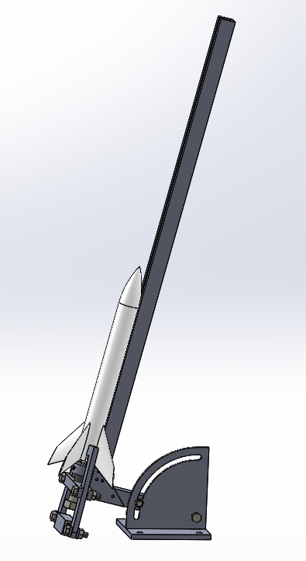
Drawing Tree – Water Rocket Launcher
EGR201-F20-01-00-1
Water Rocket Launcher
EGR201-F20-01-00-2
Clamp Subassembly
EGR201-F20-01-00-3
Rail Subassembly
EGR201-F20-01-00-4
Base Subassembly
-200 Clamp Subassembly
-201 Tee
-202 Swing Arm
-203 Link, Left
-204 Link, Right
-205 Clip
-210 Plug Subassembly
-300 Rail Subassembly
-301 Rail
-302 Base
-303 Gusset
-400 Base Subassembly
-401 Bottom Plate
-402 Upright, Left
-403 Upright, Right
Drawing Tree
Identifies each drawing and part
Defines hierarchy and structure
Defines numbering scheme

Slide 5
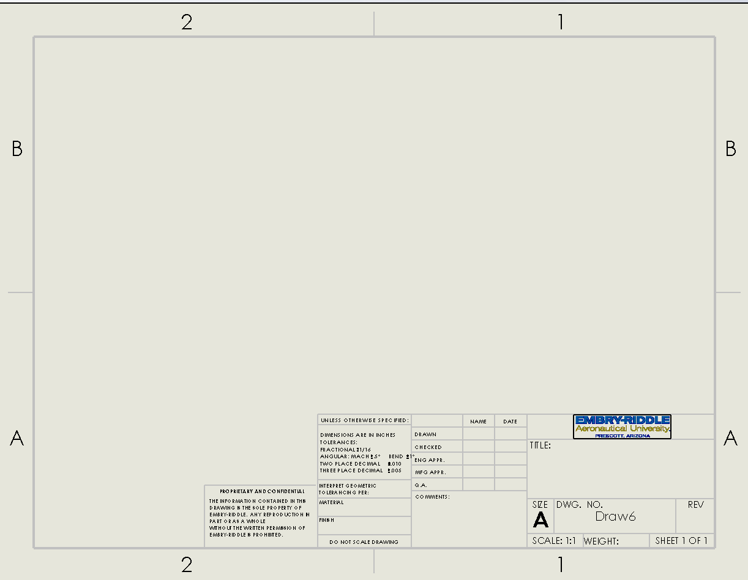
Sheet Formats
Zone Identifiers
Sheet Size
A = 8.5 x 11
B = 11 x 17
C= 17 x 22 etc.
Short descriptive title
Same on each sheet
Scale
Label view if different scale
Tolerance Block
Avoids tolerancing every dimension
First sheet only
Approvals
First sheet only
Drawing Number
Same on each sheet
Material
Only if single part
For assemblies, leave blank and define materials in BOM
First sheet only
Revision
Initial version = “N/C”
Revisions are “A”, “B”, …
Proprietary Statement
All sheets
Sheet Number
Include number of sheets

Slide 6
Assembly Drawings
Follow the drawing tree
One assembly per drawing
May include subassemblies of a common top assembly
Top assembly assigned its own part number – drawing#-dash# (e.g., EGR201-F20-01-AG-2-200)
First views define the assembly
Label primary view with assembly dash number and title
Define only the assembly, not the component parts/subassemblies
Unless the component feature is created during assembly
Identify components with balloons corresponding to BOM items
Show only dimensions created at assembly
Do not dimension component parts
Show how the assembly is put together (e.g., weld symbols, fasteners)

Slide 7
Subsequent views define component parts
Subassemblies defined on separate drawings and referenced on BOM with complete part number
Standard hardware and purchased items defined on the BOM (do not draw them)
Material stock defined on BOM
Label primary view with part number and title
Fully dimension and tolerance all manufactured features
Indicate stock dimensions (e.g., plate thickness) with “STK”

Slide 8
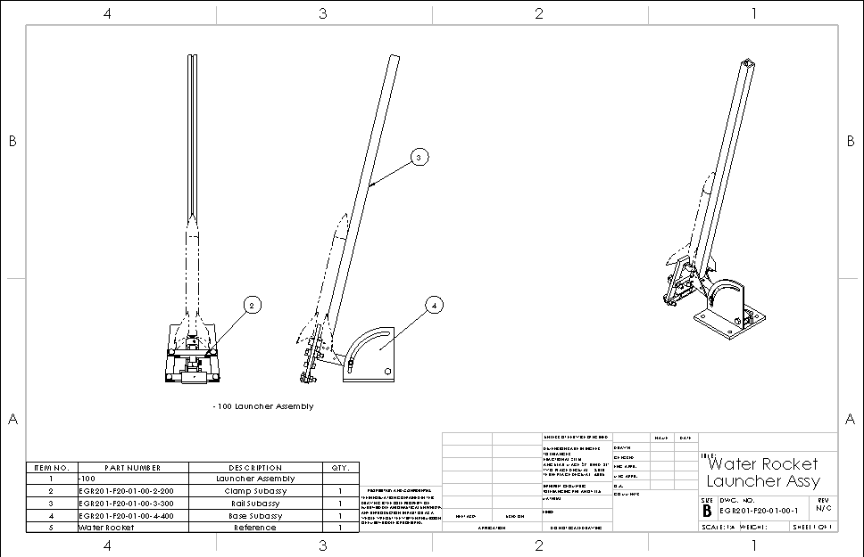
Example – Water Rocket Launcher
Balloons identify each part/subassembly
Only to level defined on this drawing
Not necessary to call out each instance
Description
Match description on drawing
Part Number
List top assembly first.
Only the Dash Number if defined on this drawing
Complete Part Number if defined elsewhere
Label primary view(s) of top assembly.
Dash number and description
Item No.
Corresponds with balloons.

Slide 9
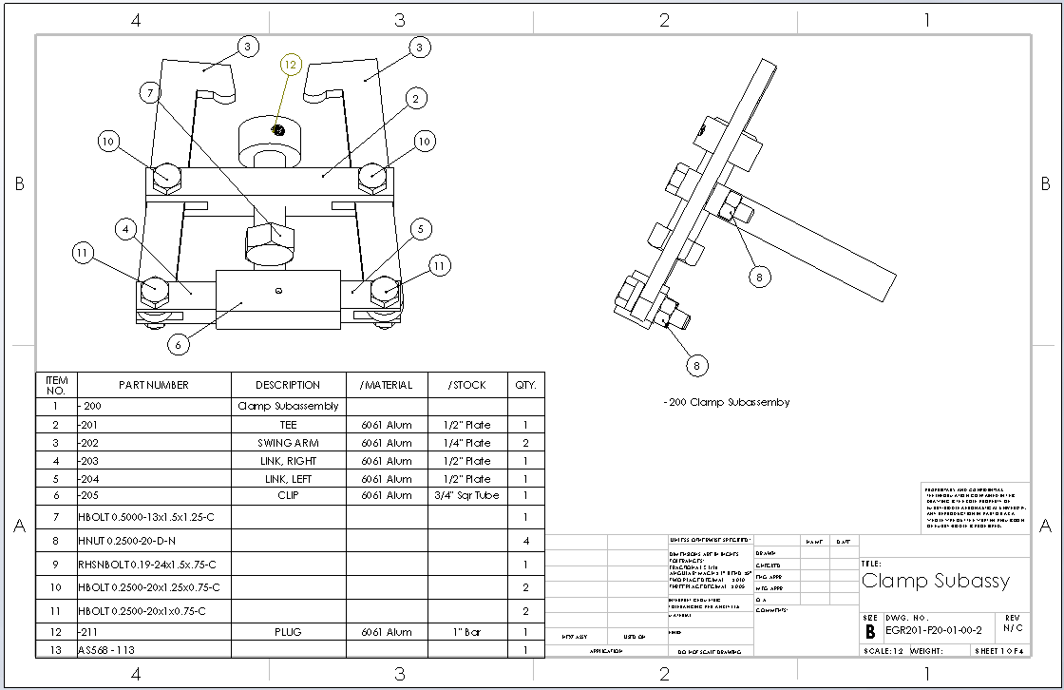
Description
Match description on drawing
Balloons identify each part/subassembly
Part Number
List top assembly first.
Dash Number only if defined on this drawing
Complete Part Number if defined elsewhere
No dimensions unless created at assembly
Label primary view(s) of top assembly.
Dash number and description
Item No.
Corresponds with balloons.
Material
Be complete – alloy, specification, temper
Better example: 6061-T6 per AMS 4025
Specification sometimes its own column
Stock
Material size as-purchased

Slide 10
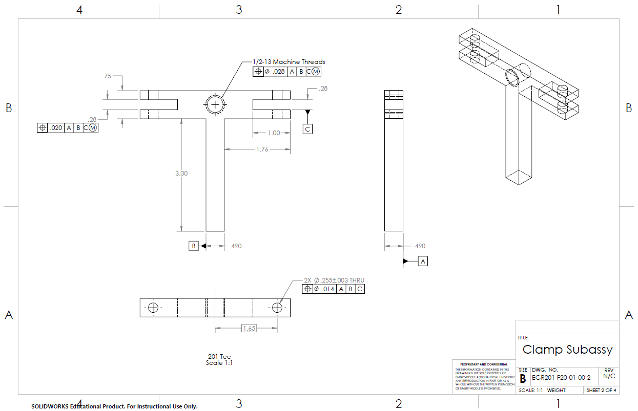
Fully dimension part. GD&T preferred.
No dimensions on isometric views
Define component parts on subsequent sheets.
Label primary view(s) of top assembly.
Dash number and description

Slide 11
Drawing Notes
“The use of manufacturing and assembly notes on assembly, subassembly, and detail drawings should be avoided whenever possible.” (Yeah, right.)
List all notes together, preferably on first sheet
Number notes sequentially (do not reuse deleted numbers)
Use separate note for unrelated requirements
Be clear, concise, and grammatically correct
Be as specific as possible without over-constraining
Reference processing specifications, etc. precisely
Do not include contractual items (e.g., cost, payment terms)
Avoid “local notes,” use “flag notes” instead

Slide 12
Flag Notes
Apply requirement/relief or clarification for a specific drawing feature
Identified by a shaped border (typically a triangle) around the number of the note.
Matching number with border attached to affected drawing feature

Slide 13
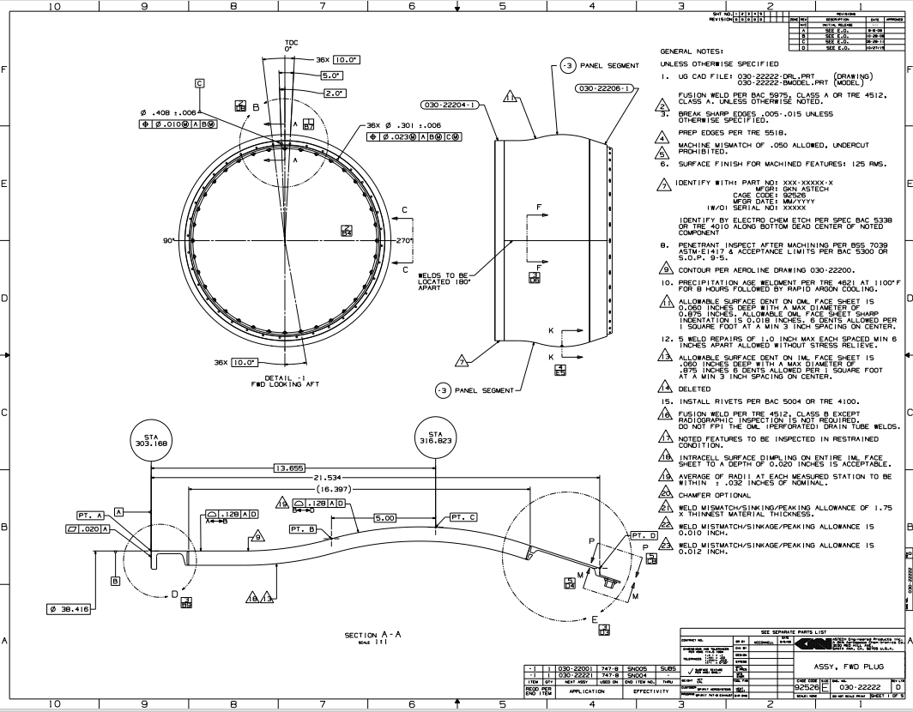

Slide 14
